Slide 1
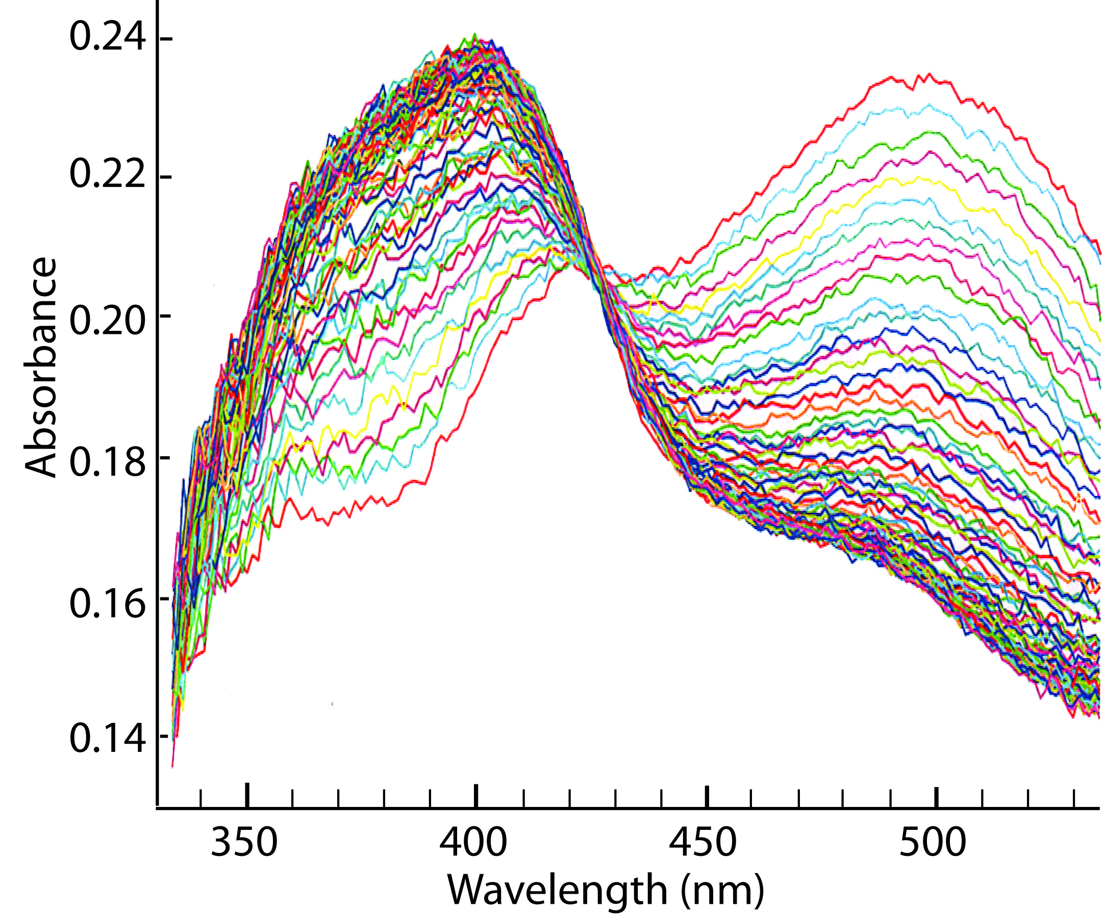
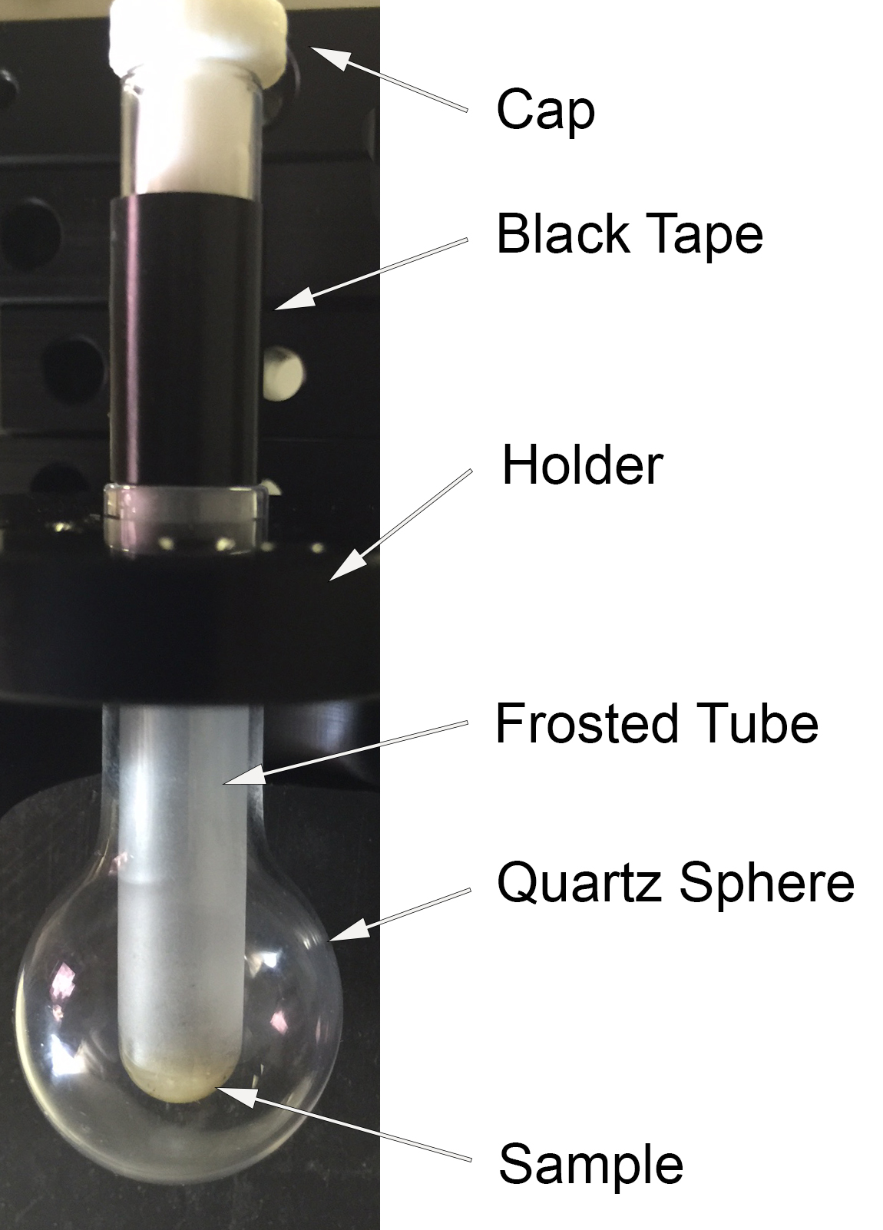
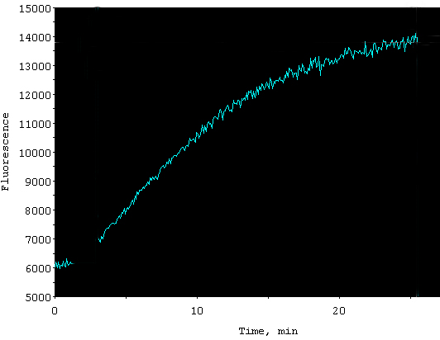
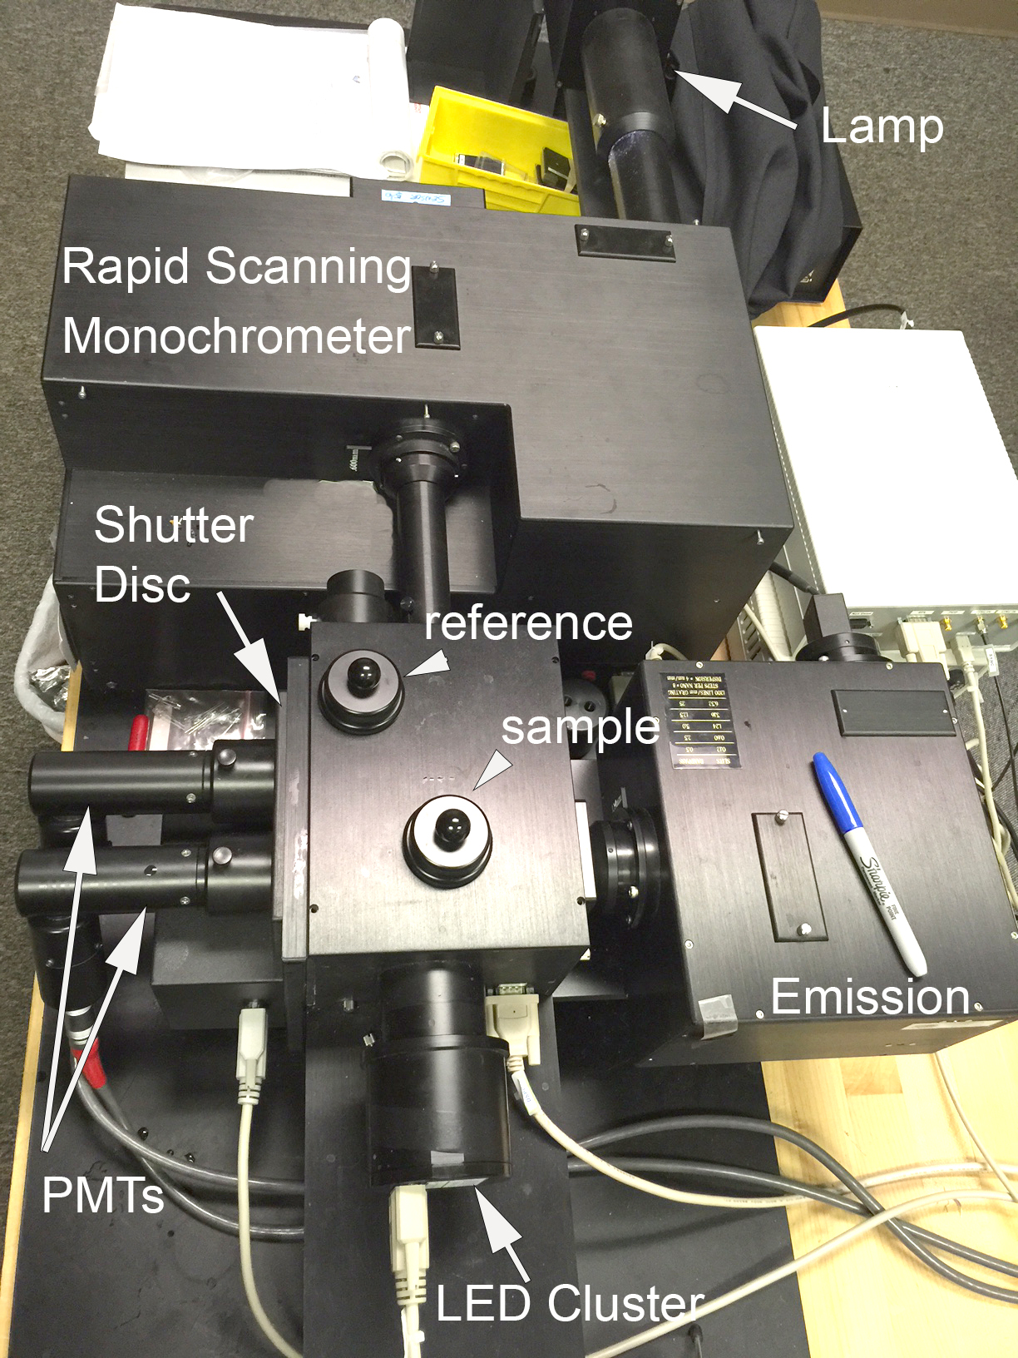
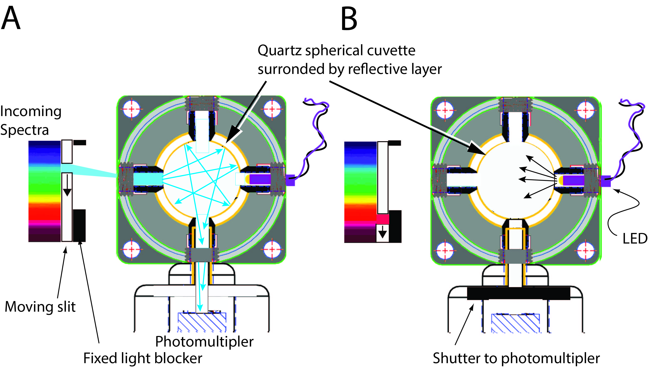
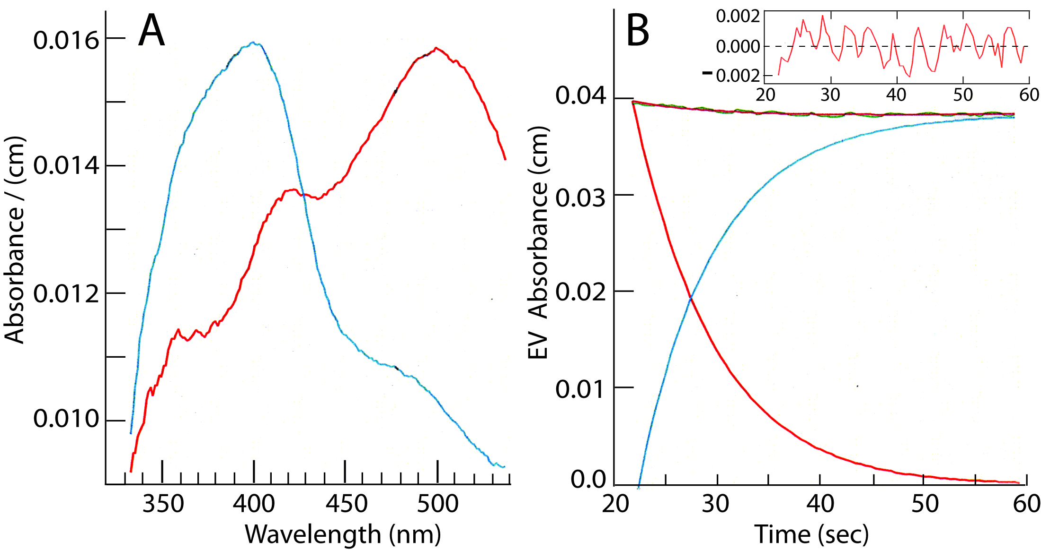
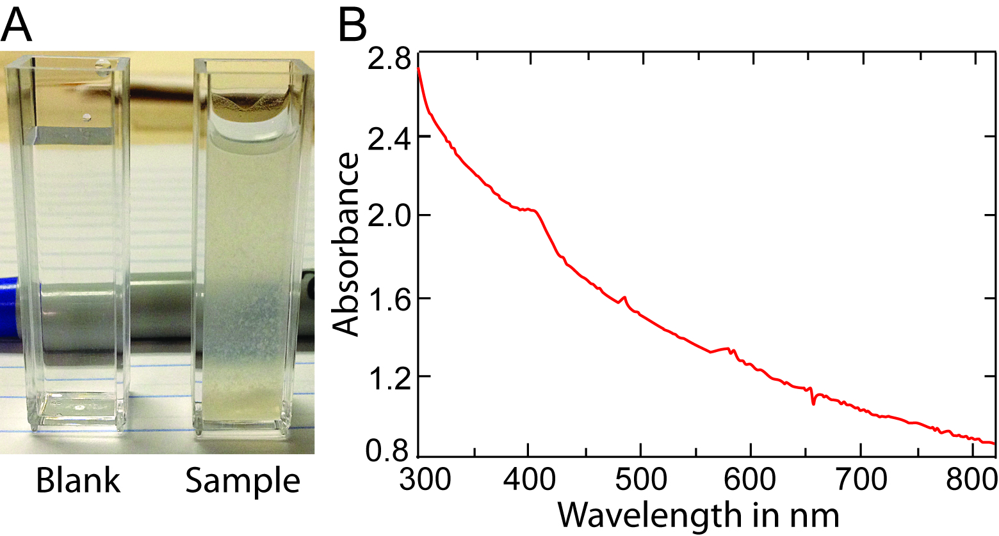
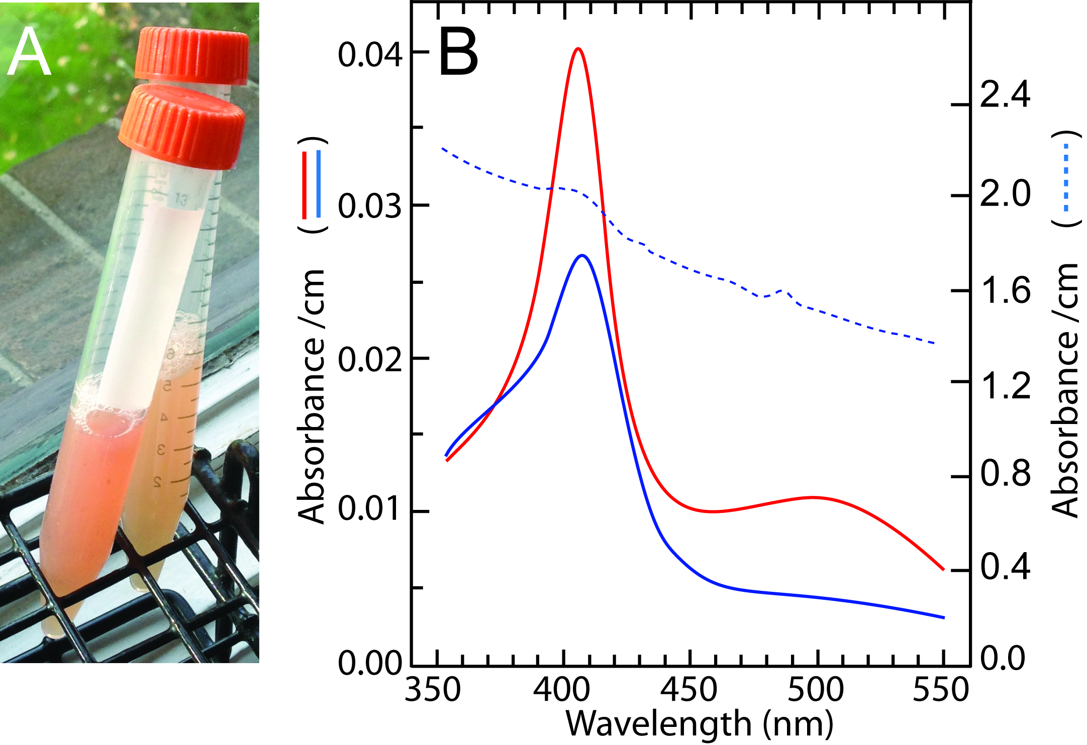
Spectral Time Sharing to Simultaneously
Measure Rhodopsin Absorbance and Retinol Fluorescence while
Mitigating Light Scatter in living frog retina suspensions
Gabriel J. Gonzalez-Fernandez¹ and Richard J. DeSa²
¹R&D Service Veterans Affairs, and Ophthalmology & Pathology University of Mississippi Center; ²Olis Inc. Bogart, GA
PURPOSE AND BACKGROUND:
METHODS AND RESULTS:
Goal - monitor retinoid delivery/removal in photoreceptor suspensions and intact retinas. This will facilitate studies of the retinoid cycle (Fig 1). Spectroscopy of cellular suspensions has been severely limited by light scattering (Fig 2). We previously described a method to mitigate light scatter allowing spectral measurement of rhodopsin in cellular suspensions and isolated neural retina (Gonzalez-Fernandez and DeSa, 2015 ARVO abstract). There, we replaced the traditional rectangular cuvette with an integrating sphere. Here, we extend the capabilities for fluorescence.
Fig 3. Spherical integrating absorption cuvette. The interference of light scattering is mitigated through a spherical cuvette surrounded by a reflective material scattering the beam (yellow lines). Path-length and sensitivity are markedly increased compared to rectangular cuvette. DeSa Presentation Chamber (DSPC).
Fig 1. the Visual Cycle involves the exchange of retinoids between multiple cell types. Light scattering limits the usefulness of otherwise powerful spectroscopic methods that require transparent samples. Cellular suspensions and intact retinal tissues are required because the visual cycle represents a collaborative interaction necessitating intact cellular relationships. (From Gonzalez-Fernandez, 2012).
Fig 8. Fluorescence measurements. Left: Frosted tube insert within integrating cavity. Right: Time course of fluorescence (Ex, 360 nm; Ex > 440 Em, using long-pass filter).
Fig 6. Rhodopsin spectrum of dispersed frog retina within the integrating cavity absorption chamber. Scans: 40 sec at 2 scans/sec with exposure to 515 nm LED at 100 flashes/sec..
Fig. 7. Spectral analysis of Fig. 7 data set. Absorbance was corrected according to Javorfi et al (2006)⁶. A) Red, pre-bleach; blue, post-bleach spectra. B) Data was fit to two species: A -> B with rate constant of 0.132 sec^{-1.}
Fig 9. Interleaving absorbance scans with fluorescence measurements. A) Scan Phase: The moving slit creates 100 scans per second. Each integrating chamber has 4 light ports. B) Excitation light pulse: A fixed light-block creates a dark period within each scan. During this period, the LED is triggered, and the photomultiplier shutter is momentarily closed.
.
Fig 4. Rapid Scanning Monochrometer with Dual beam CLARITY integration chambers. LED cluster provides excitation pulse for fluorescence measurements for the emission monochrometer that can be used in scan or in total fluorescence (long pass filter) modes.
SUMMARY:
REFERENCES:
Spectral measurements of light-scattering cellular suspensions and intact retina are possible with a spherical integrating cavity. The use of a tube insert extends the usefulness by allowing small volume samples. The LED cluster and emission monochrometer allow fluorescence measurements. Time allows interleaving absorbance scans with fluorescence measurements. These methods provide new ways to analyze the visual cycle in living systems.
Gonzalez-Fernandez, F. (2012). Interphotoreceptor retinoid-binding protein (IRBP) – myths and mysteries. J. Ophthalmic Vis. Res. 7(1):100-104.
Koutalos Y, Cornwall MC. Microfluorometric measurement of the formation of all-trans-retinol in the outer segments of single isolated vertebrate photoreceptors. Methods Mol Biol 2010;652:129-147.
Javorfi T, Erostyak J, Gal J, et al. Quantitative spectrophotometry using integrating cavities. J Photochem Photobiol B 2006;82:127-131.
5. Fry ES, Kattawar GW, Strycker BD, Zhai PW. Equivalent path lengths in an integrating cavity: comment. Appl Opt 2010;49:575-577.
Fig 2. Upper: Standard configuration with rectangular cuvette. Light scatter limits the usefulness for cell and tissue suspensions. Spectra from turbid suspensions can be obtained by moving the detector closer to the cuvette compartment (dashed lines). Nevertheless, light scatter remains a significant problem. Lower: Rayleigh scattering prevents informative spectral information of a suspension of bleached bovine outer segments (sample - panel A, compare with Fig 5).
ACKNOWLEGEMENTS:
The authors thank Dr. Yiannis Koutalos (MUSC), and Julie Ann DeSa Lorenz and Dr. Kyril Sointev (Olis Inc.) for helpful discussions. Support: VA R&D grant I01BX007080, /NEI grant EY09412, Pilot Study Award from PathRD llc; Activation Award from the VA Office of Research Development; Start-Up Grant from Research Mississippi! to the laboratory of Federico Gonzalez-Fernandez.
Fig 5. Rhodopsin spectra. A) Crude outer segment suspension before (left) and after (right) bleaching. B) Before (red), and after (blue) bleaching under direct sunlight. Beached suspension in traditional spectrophotmeter.

